Slide 1
Artificial intelligence
Autumn 2008
Instructor: Wang Xiaolong
Harbin Institute of Technology, Shenzhen Graduate School
Intelligent Computation Research Center
(HITSGS ICRC)

Slide 2
XIV. Bayesian networks
(section 4-5)
Autumn 2008
Instructor: Wang Xiaolong
Harbin Institute of Technology, Shenzhen Graduate School
Intelligent Computation Research Center
(HITSGS ICRC)

Slide 3
Outlines
Exact inference by enumeration
Exact inference by variable elimination
Approximate inference by stochastic simulation
Approximate inference by Markov chain Monte Carlo

Slide 4

Inference tasks
Simple queries: compute posterior marginal
Conjunctive queries:
Optimal decisions: decision networks include utility information;
  probabilistic inference required for
Value of information: which evidence to seek next?
Sensitivity analysis: which probability values are most critical?
Explanation: why do I need a new starter motor?

Slide 5
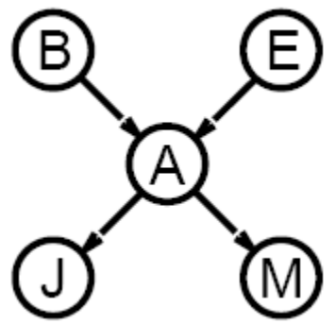
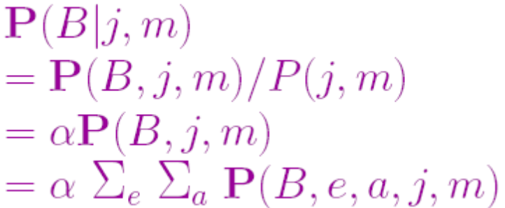
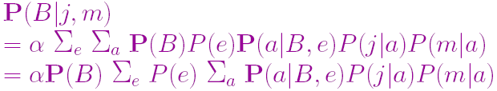


Inference by enumeration
Slightly intelligent way to sum out variables from the joint without actually constructing its explicit representation
Simple query on the burglary network:
Rewrite full joint entries using product of CPT entries:
Recursive depth-first enumeration: space, time
Notes:
CPT=conditional probability table.
n个d种取值变量.

Slide 6
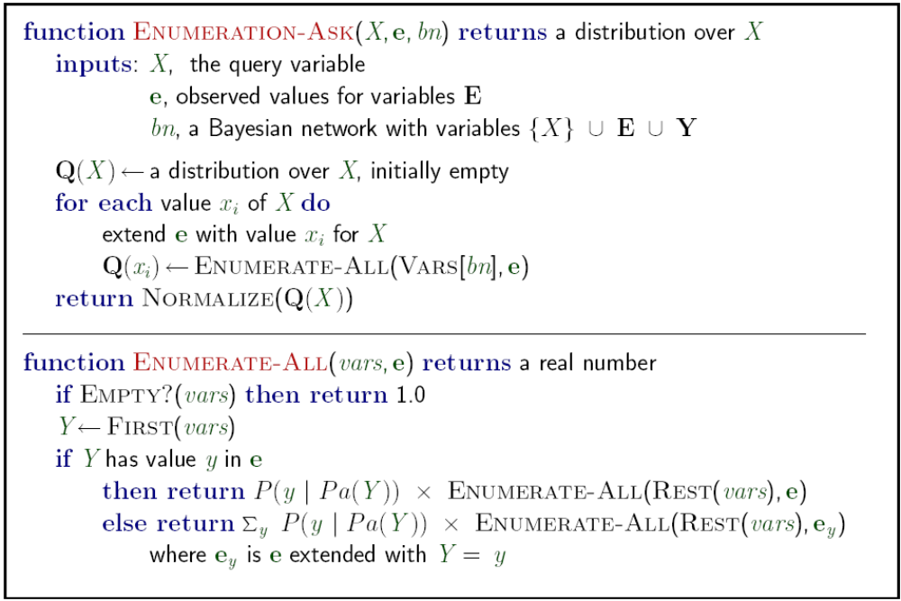
Enumeration algorithm

Slide 7
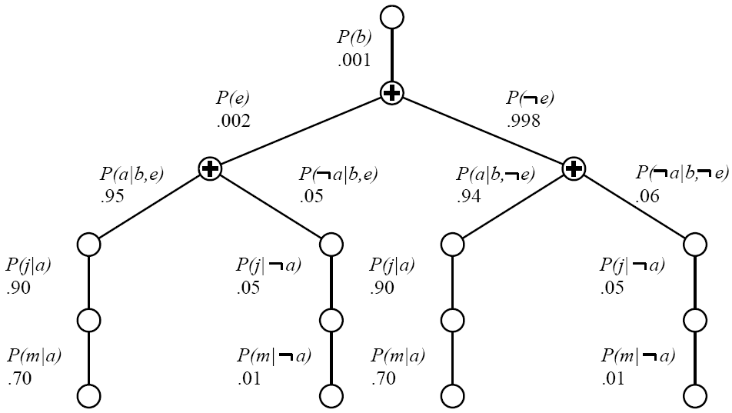
Evaluation tree
Enumeration is inefficient: repeated computation

Slide 8
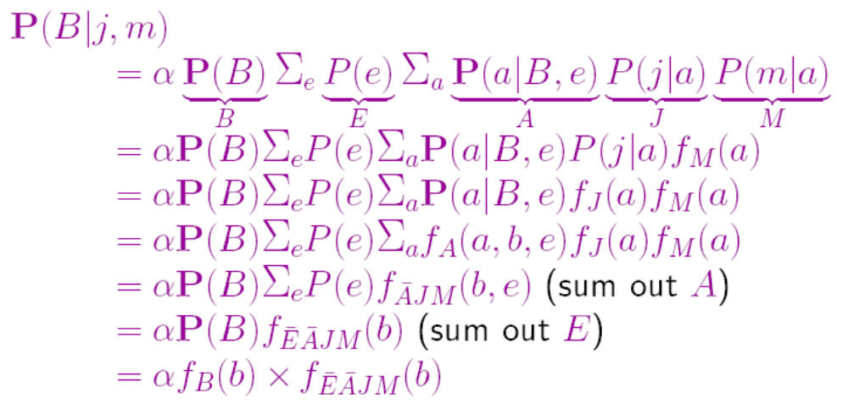
Inference by variable elimination
Variable elimination: carry out summations right-to-left, storing intermediate results (factors) to avoid recomputation

Slide 9
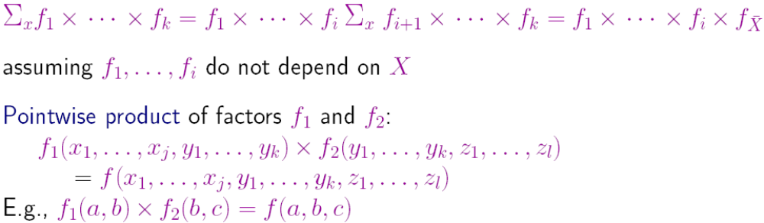
Variable elimination: Basic operations
Summing out a variable from a product of factors:
  move any constant factors outside the summation
  add up submatrices in pointwise product of remaining factors

Slide 10
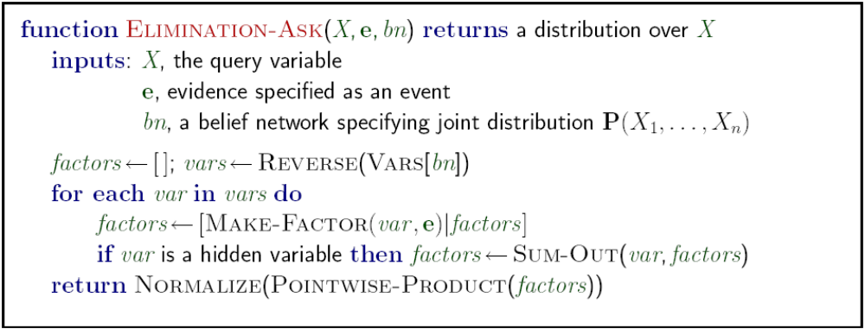
Variable elimination algorithm

Slide 11
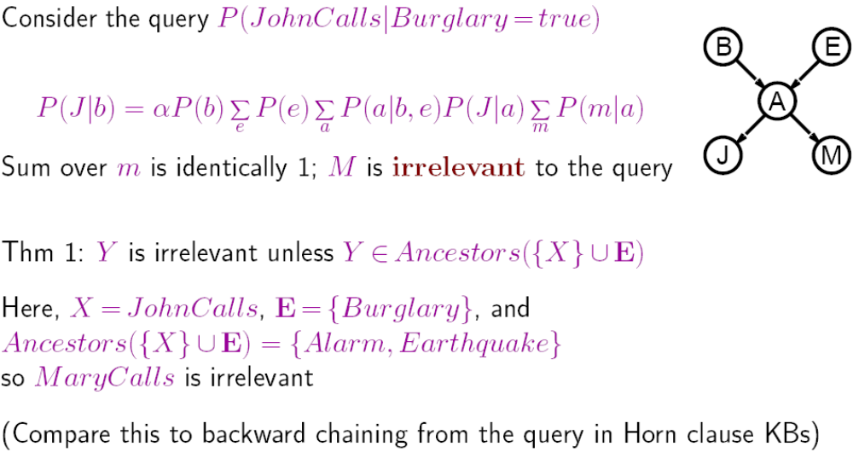
Irrelevant variables

Slide 12

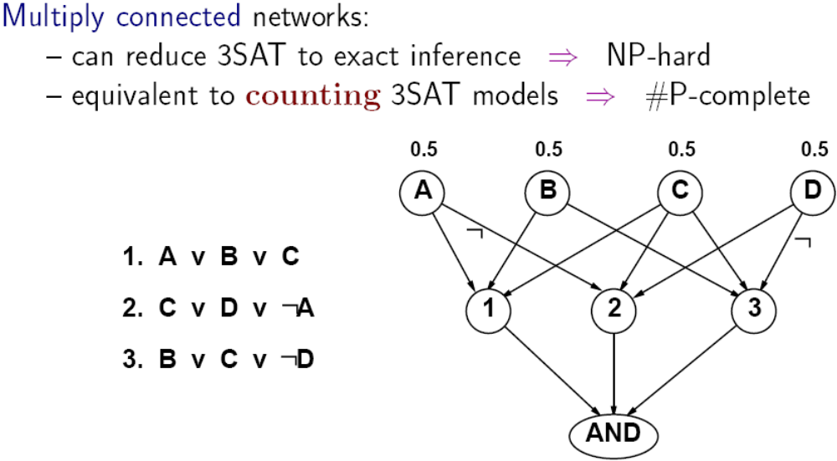
Complexity of exact inference
Singly connected networks (or polytrees):
  any two nodes are connected by at most one (undirected) path
  time and space cost of variable elimination are
Notes:
SAT:SAT的一个实例是k个布尔变量1 x ，…， k x 的m个布尔表达式1 A ，…， m A 。若存在
各布尔变量i x (1≤i≤k)的0，1 赋值，使每个布尔表达式i A (1≤i≤m)都取值1，则称布尔表
达式1 A 2 A … m A 是可满足的。
k-SAT:如果一个布尔合取范式的每个乘积项最多是k个因子的析取式，就称之为k元合取范式，
简记为k-CNF。一个k-SAT问题是判定一个k-CNF是否可满足。特别地，当k=3 时，3-SAT
问题在NP完全问题树中具有重要地位。

Slide 13


Inference by stochastic simulation
Basic idea:
1) Draw N samples from a sampling distribution S
2) Compute an approximate posterior probability
3) Show this converges to the true probability P
Outline:
  Sampling from an empty network
  Rejection sampling: reject samples disagreeing with evidence
  Likelihood weighting: use evidence to weight samples
  Markov chain Monte Carlo (MCMC): sample from a stochastic process whose stationary distribution is the true posterior

Slide 14
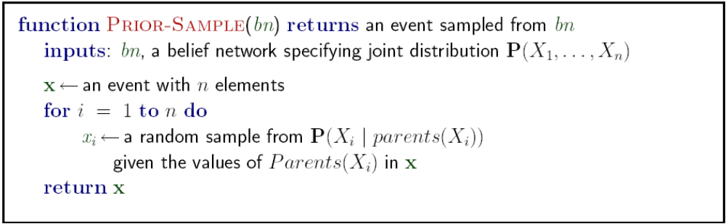
Sampling from an empty network

Slide 15
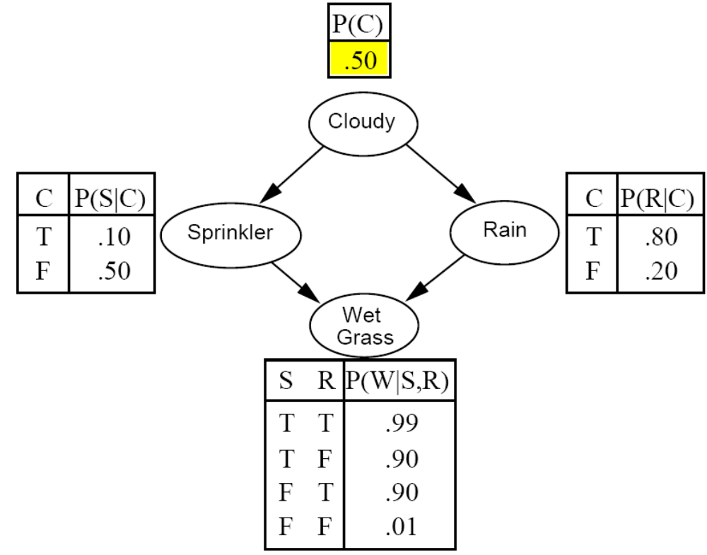
Example

Slide 16
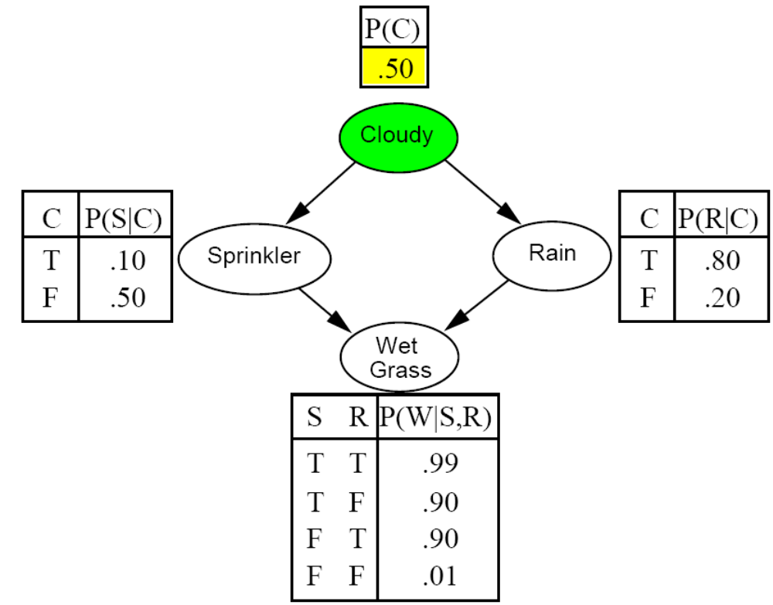
Example

Slide 17
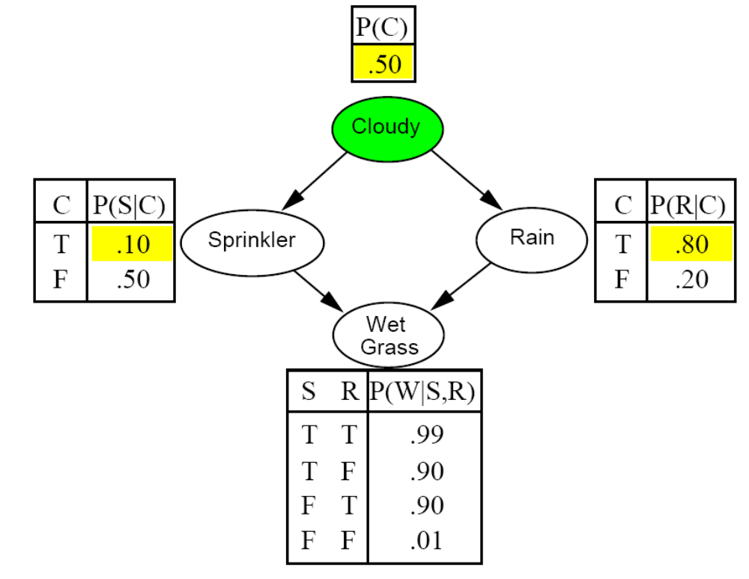
Example

Slide 18
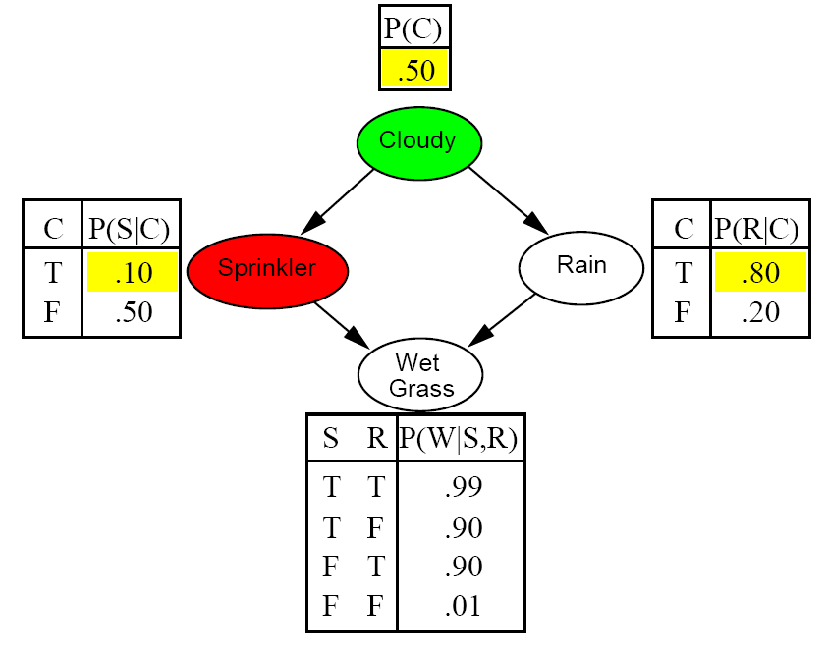
Example

Slide 19
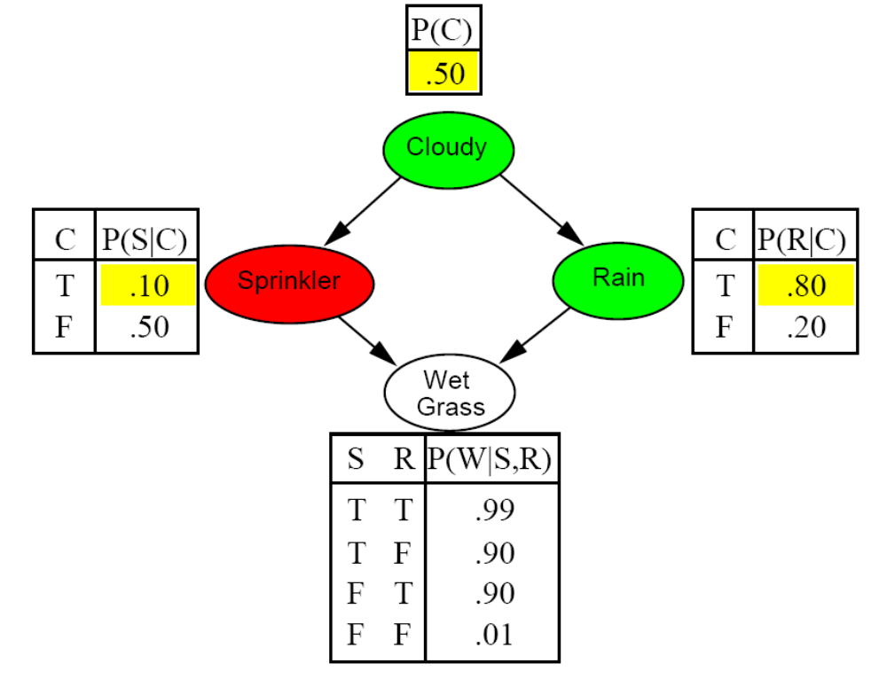
Example

Slide 20
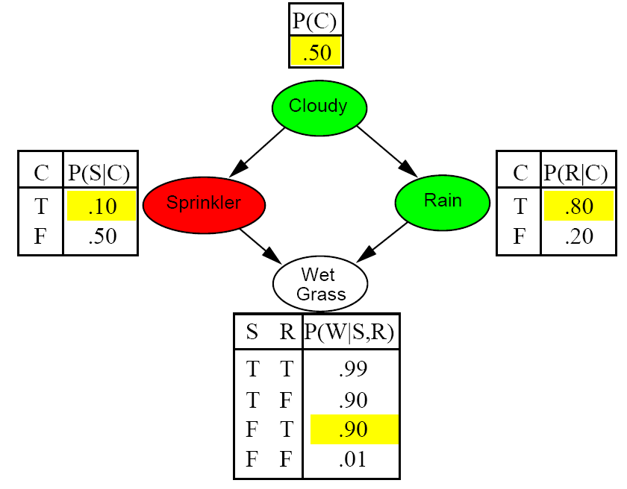
Example

Slide 21
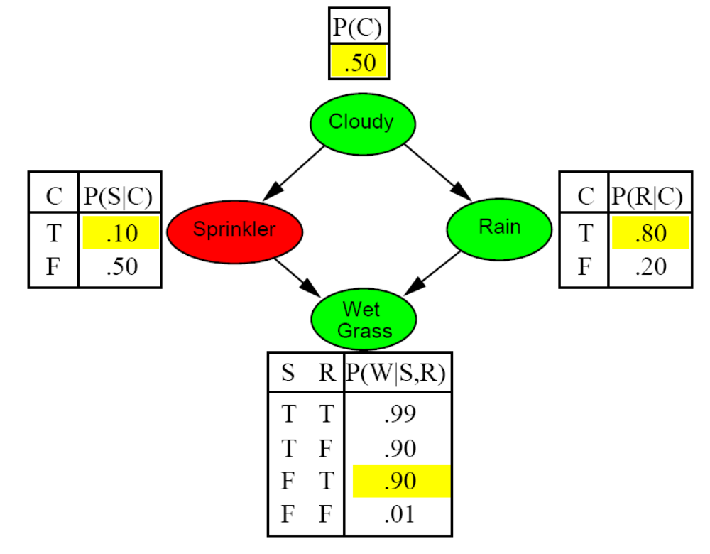
Example

Slide 22
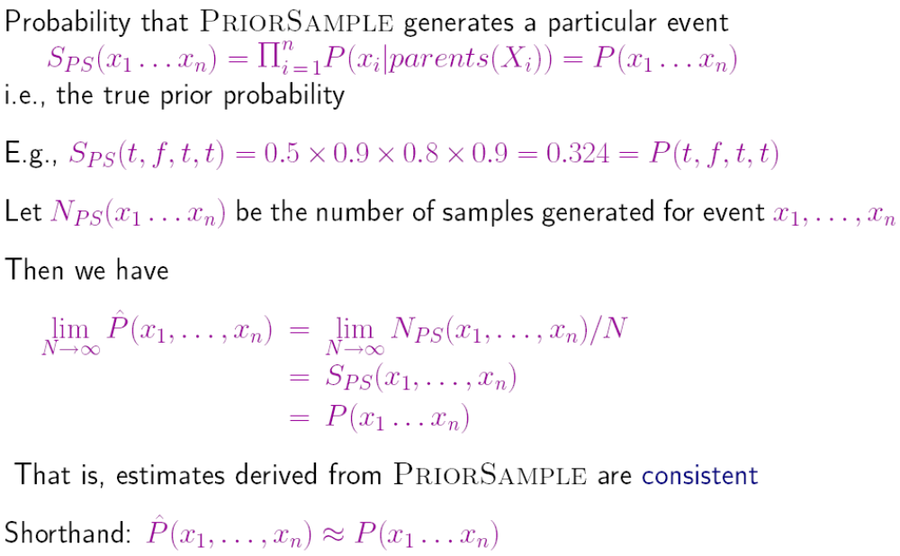
Sampling from an empty network contd.

Slide 23
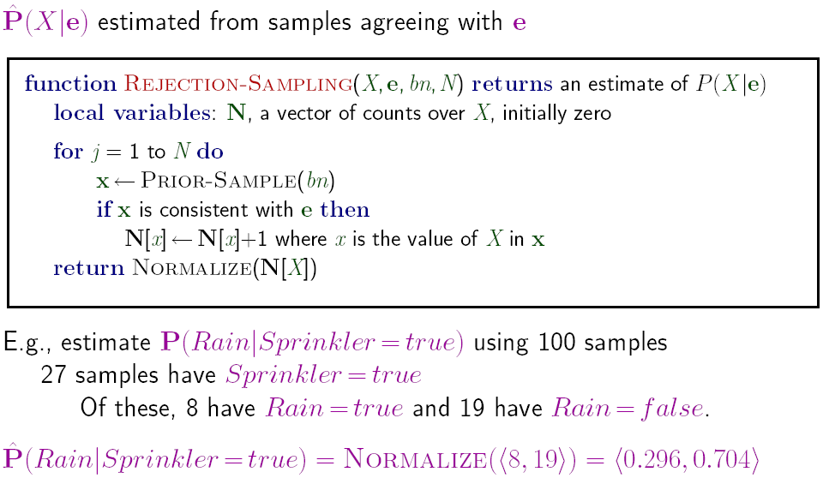
Rejection sampling
Similar to a basic real-world empirical estimation procedure

Slide 24
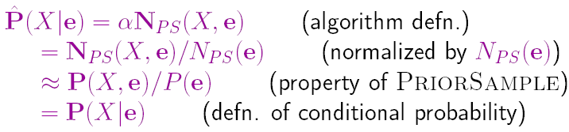
Analysis of rejection sampling
Hence rejection sampling returns consistent posterior estimates
Problem: hopelessly expensive if P(e) is small
P(e) drops off exponentially with number of evidence variables!

Slide 25
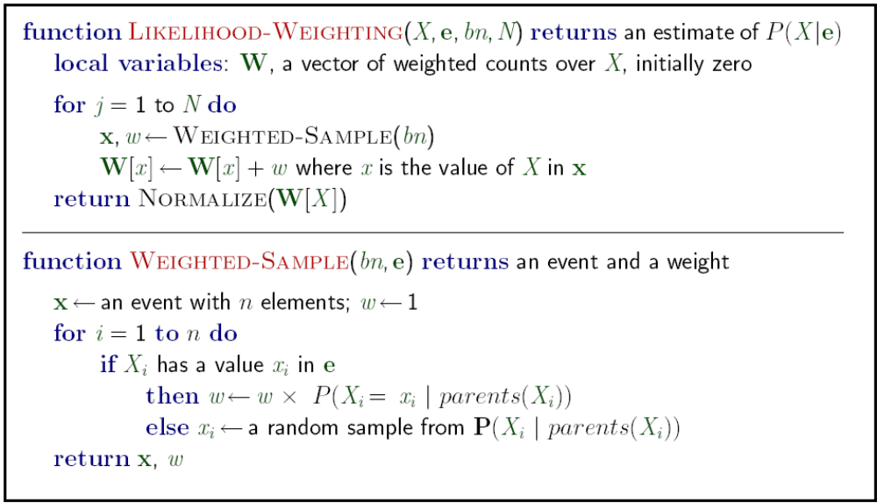
Likelihood weighting
Idea: fix evidence variables, sample only nonevidence variables, and weight each sample by the likelihood it accords the evidence

Slide 26
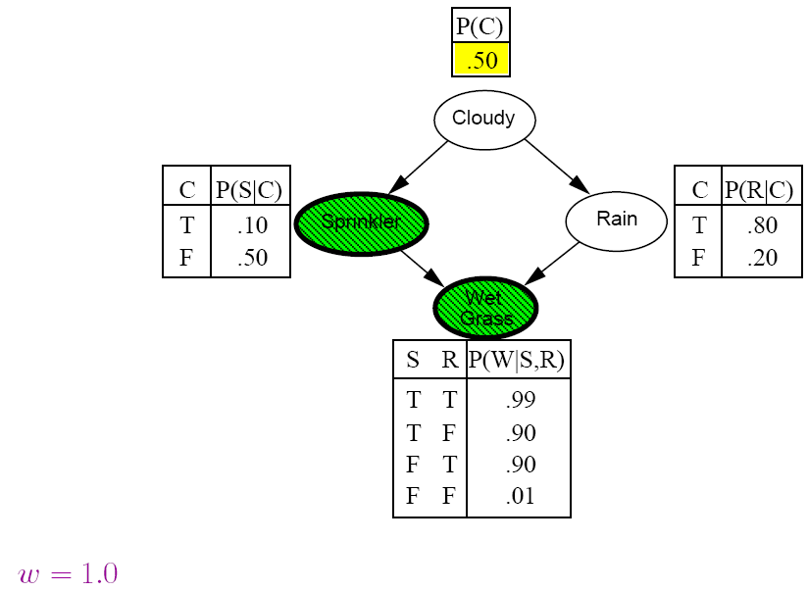
Likelihood weighting example

Slide 27
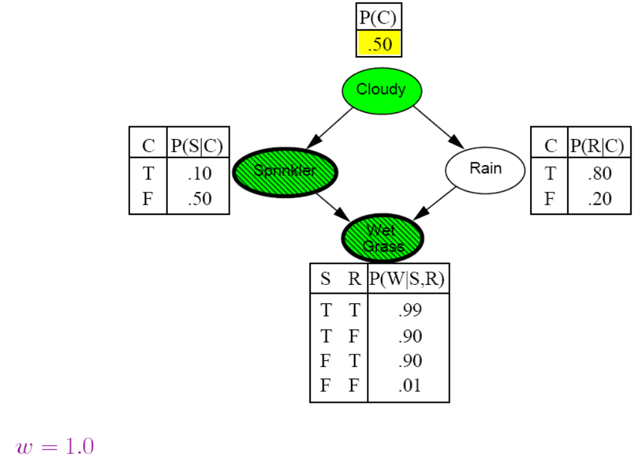
Likelihood weighting example

Slide 28
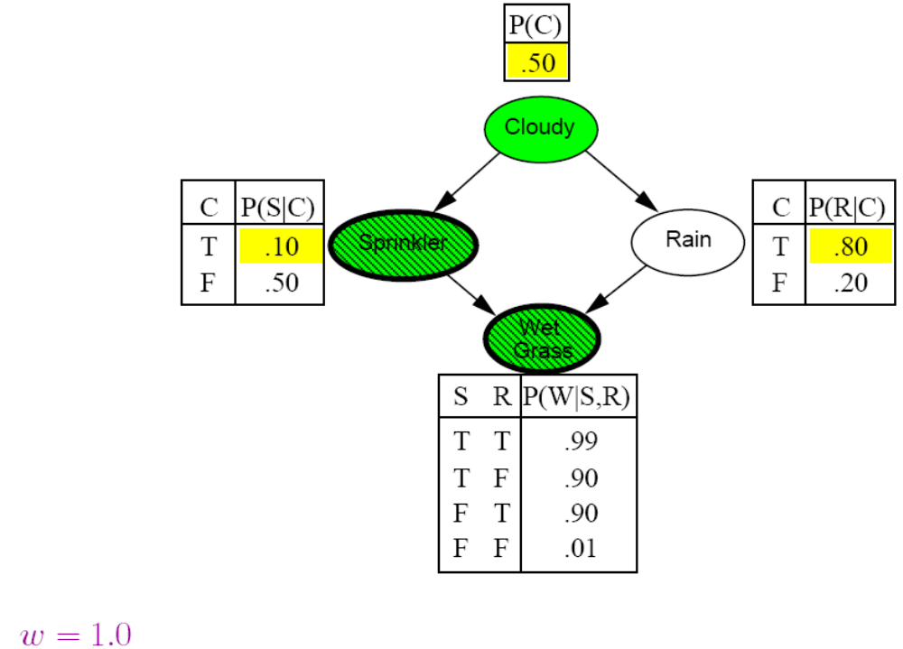
Likelihood weighting example

Slide 29

Likelihood weighting example

Slide 30
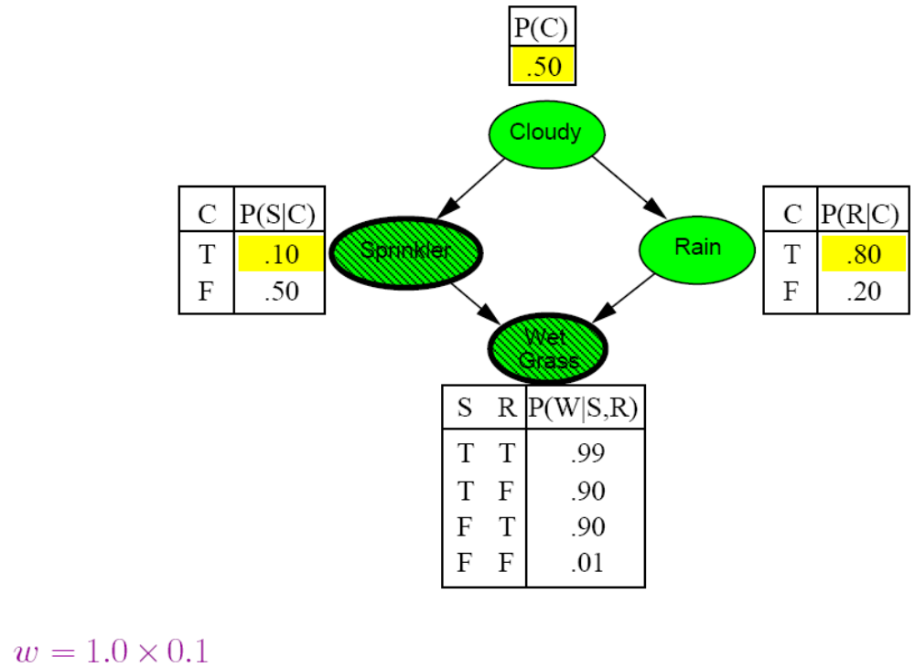
Likelihood weighting example

Slide 31
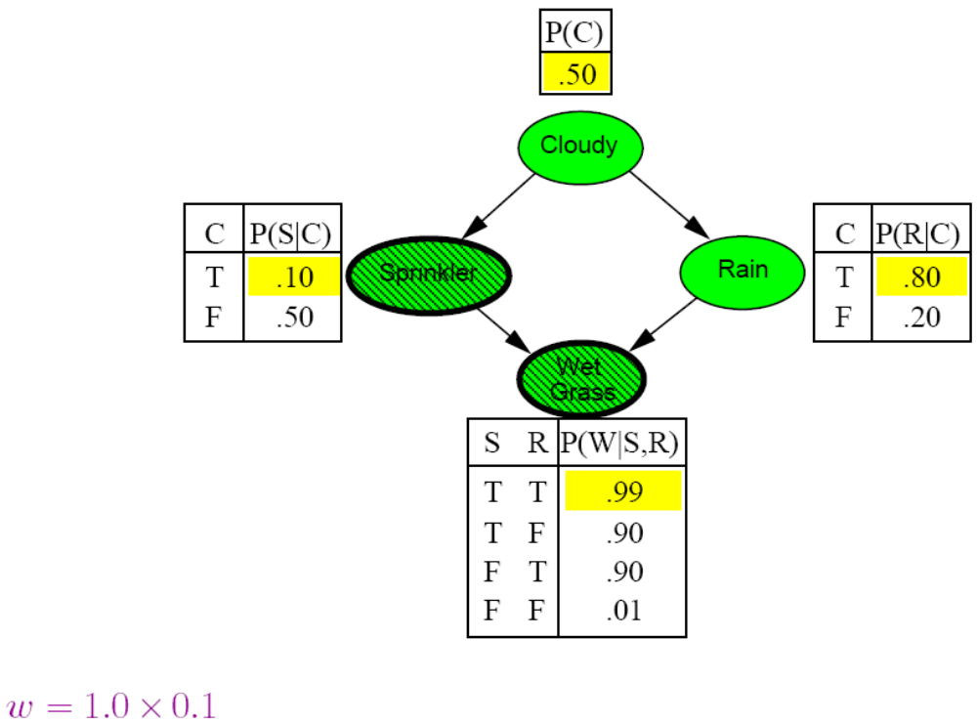
Likelihood weighting example

Slide 32
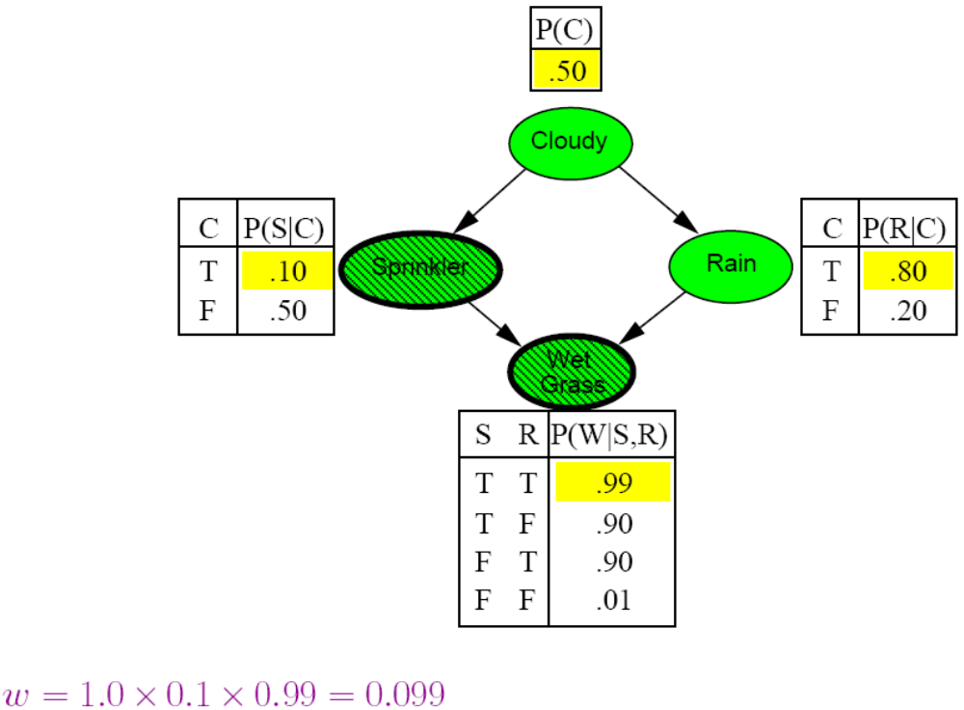
Likelihood weighting example

Slide 33
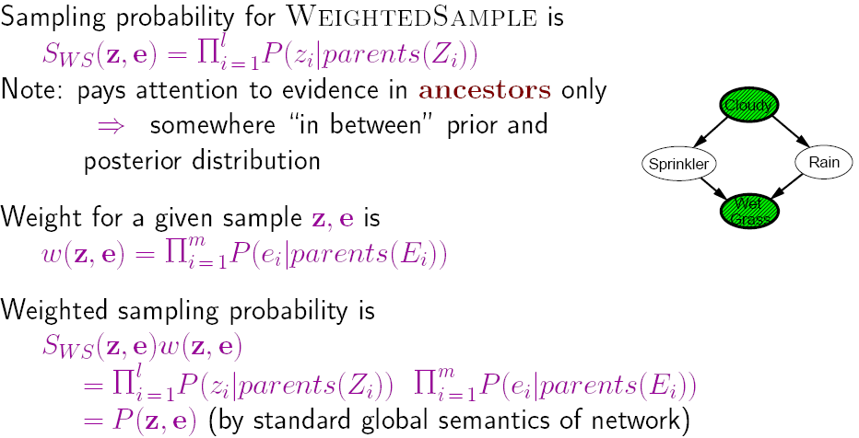
Likelihood weighting analysis
Hence likelihood weighting returns consistent estimates but performance still degrades with many evidence variables because a few samples have nearly all the total weight

Slide 34
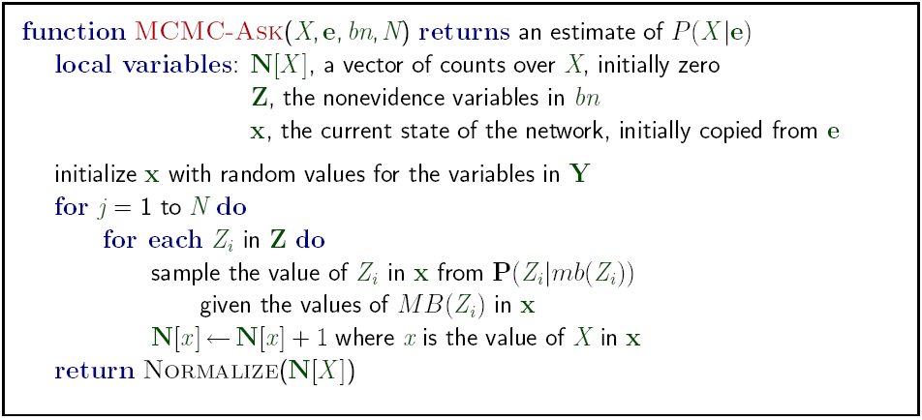
Approximate inference using MCMC
“State” of network = current assignment to all variables.
Generate next state by sampling one variable given Markov blanket
Sample each variable in turn, keeping evidence fixed
Can also choose a variable to sample at random each time

Slide 35
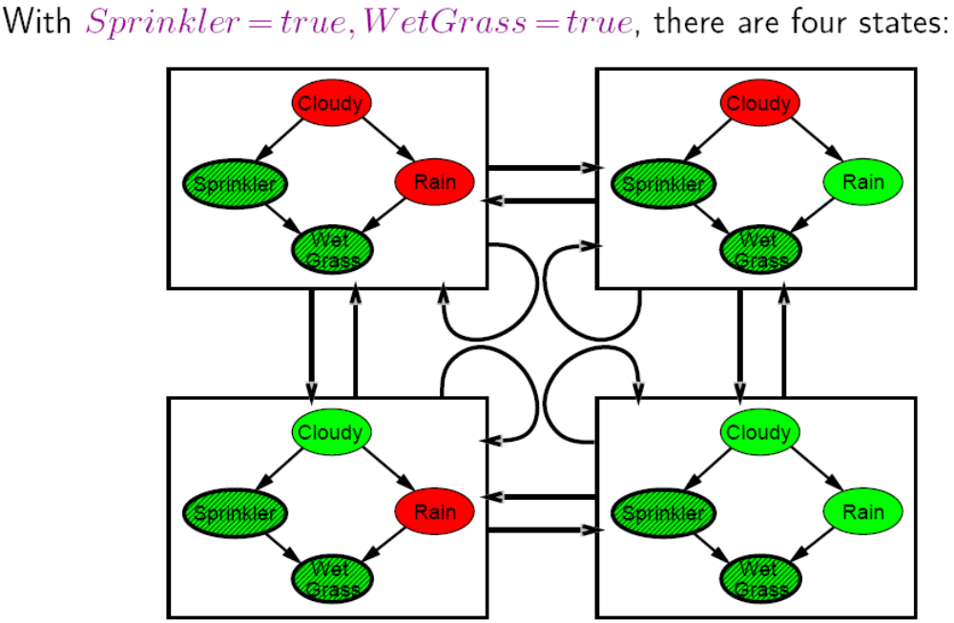
The Markov chain
Wander about for a while, average what you see

Slide 36
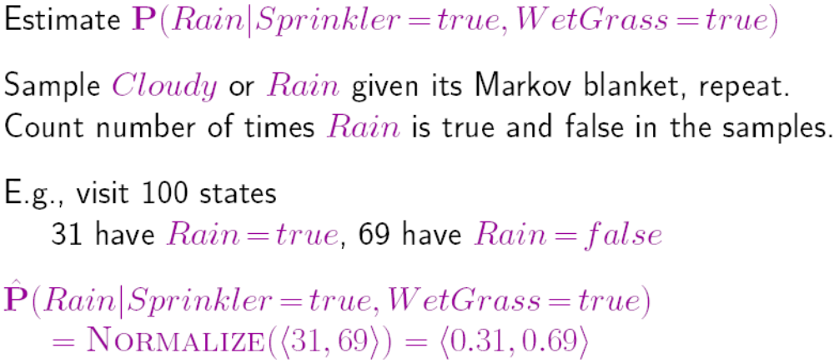
MCMC example contd.
Theorem: chain approaches stationary distribution:
long-run fraction of time spent in each state is exactly proportional to its posterior probability

Slide 37
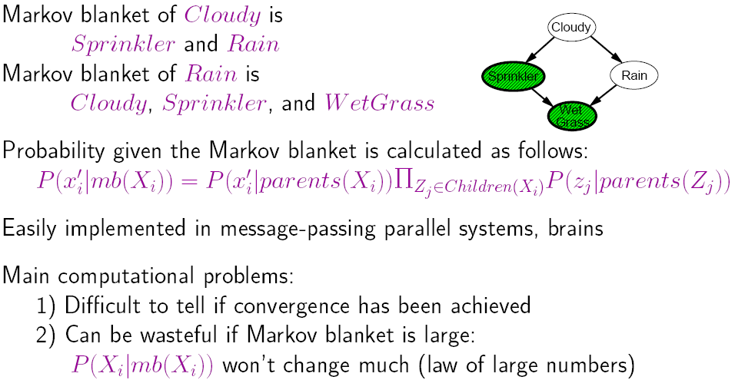
Markov blanket sampling

Slide 38
Summary
Exact inference by variable elimination:
  polytime on polytrees, NP-hard on general graphs
  space = time, very sensitive to topology
Approximate inference by LW, MCMC:
  LW does poorly when there is lots of (downstream) evidence
  LW, MCMC generally insensitive to topology
  Convergence can be very slow with probabilities close to 1 or 0
  Can handle arbitrary combinations of discrete and continuous variables

Slide 39
Assignments
Ex 14.3, 14.11

